Slide 1
Quantum Computing Architectures (EE274) Lecture 5
Hiu-Yung Wong
feb. 6, 2025
hiuyung.wong@sjsu.edu, Office: ENG363
http://www.sjsu.edu/people/hiuyung.wong/index.html

Slide 2
Outline
Measurement
Pauli Matrices
Density Matrix

Slide 3
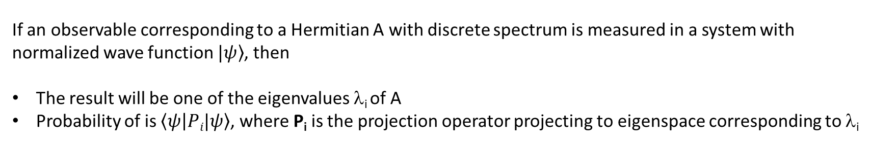

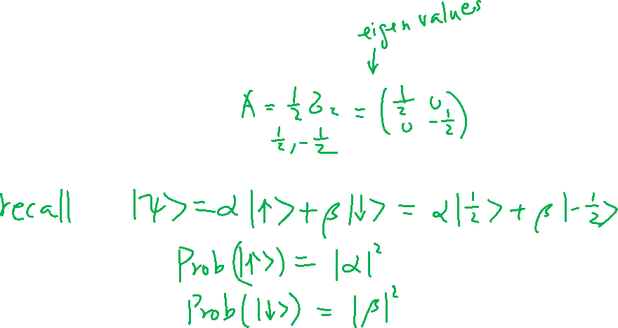
Hermitian Matrix, Measurement, and Projection Operator
From last lecture
Learning outcomes: All observables are associated with a Hermitian Matrix.
If an observable corresponding to a Hermitian A with discrete spectrum is measured in a system with normalized wave function $|\left.ψ\right\rangle$, then
The result will be one of the eigenvalues λ_{i} of A
Probability of is $\left\langle ψ | Pi|ψ\right\rangle$, where P_{i} is the projection operator projecting to eigenspace corresponding to λ_{i}

Slide 4
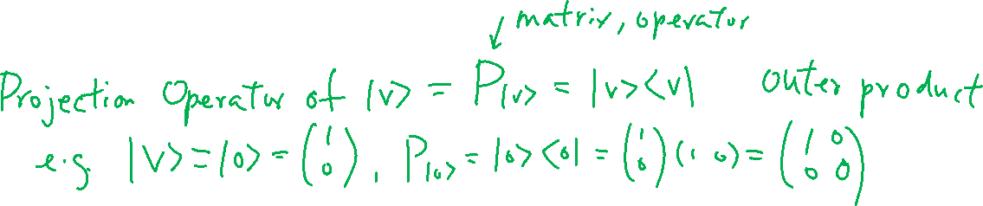
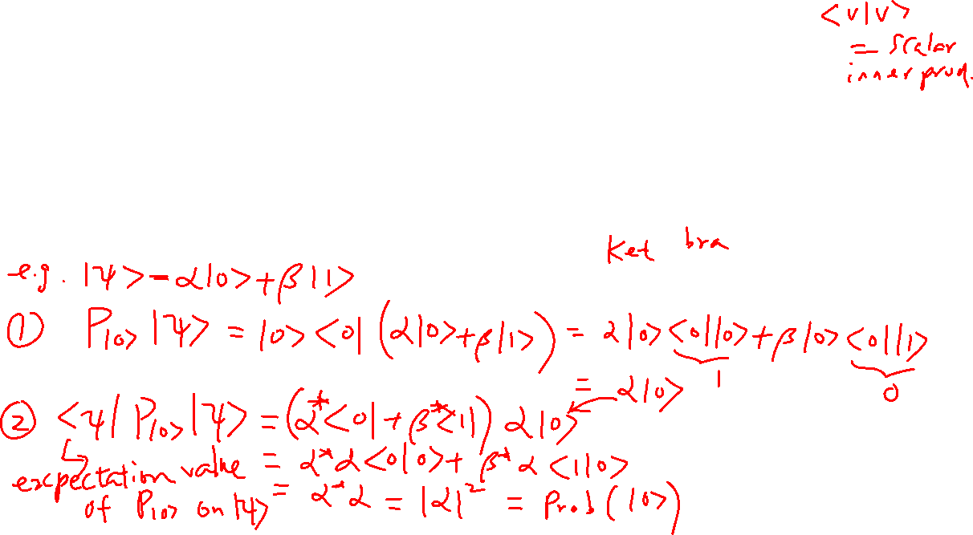
Projection Operator and Measurement Probability

Slide 5
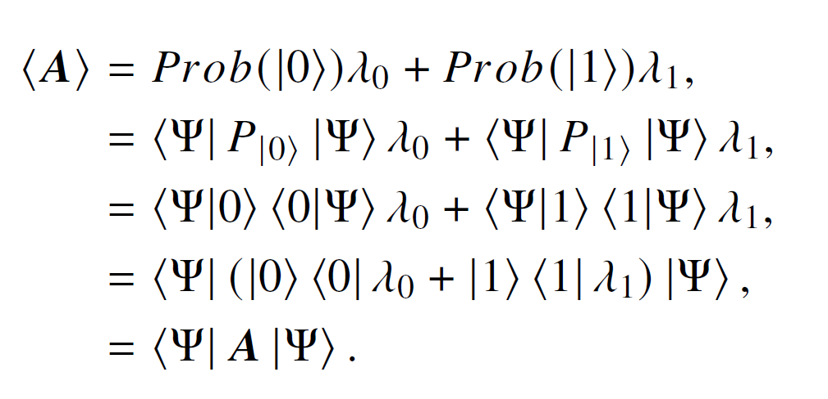
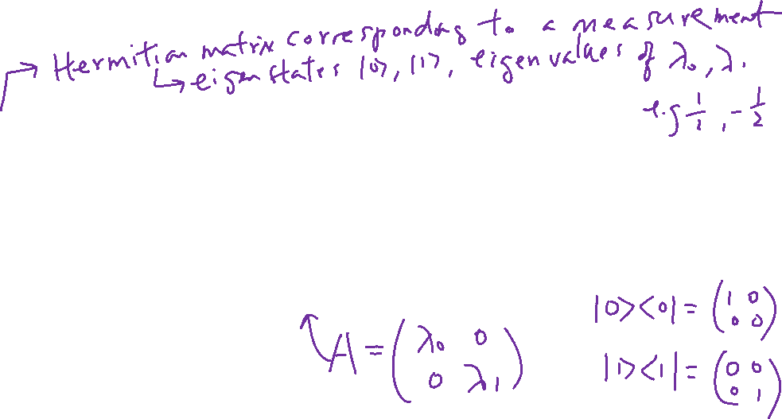
Expectation Value of Measurement using Projection Operator

Slide 6
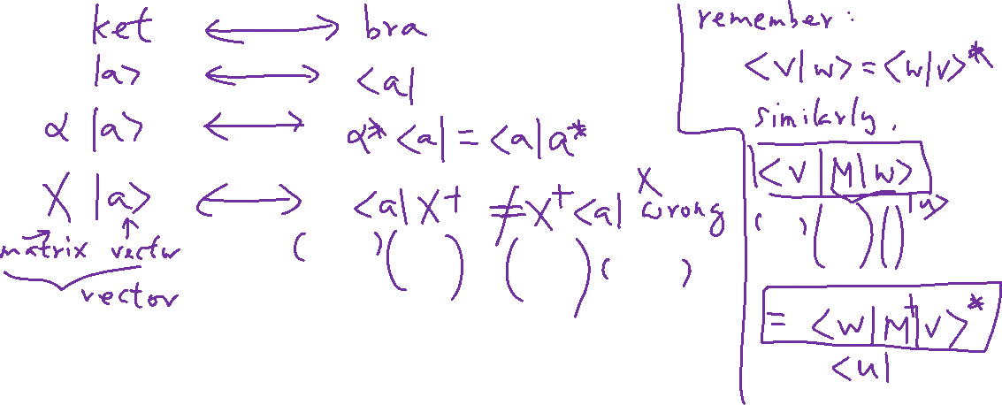
Dual Correspondence with Matrices

Slide 7
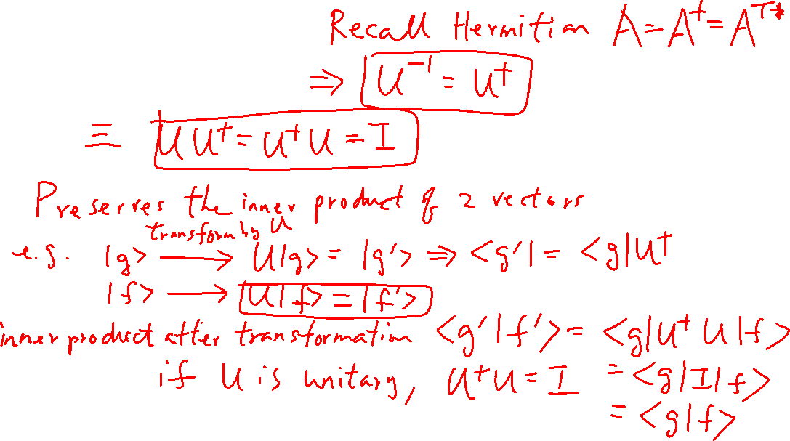
Unitary Matrix

Slide 8
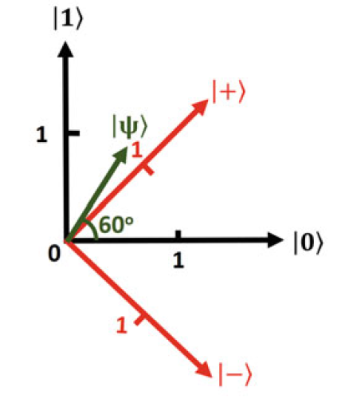
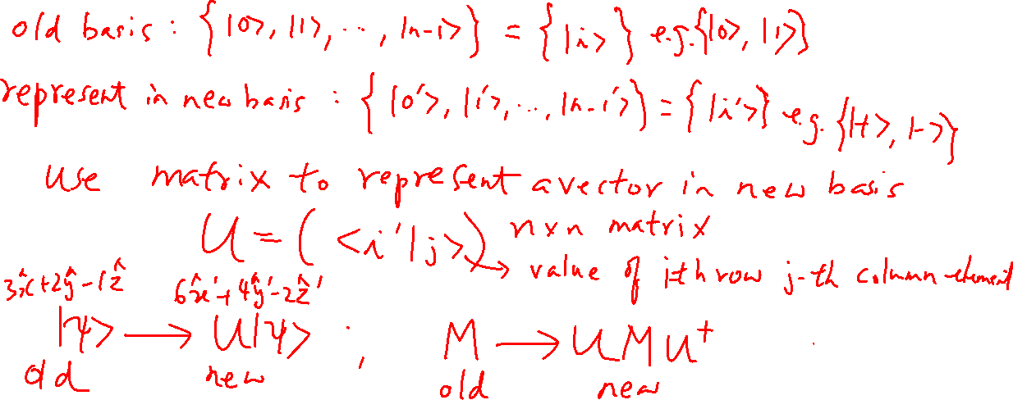
Transformation Matrix

Slide 9
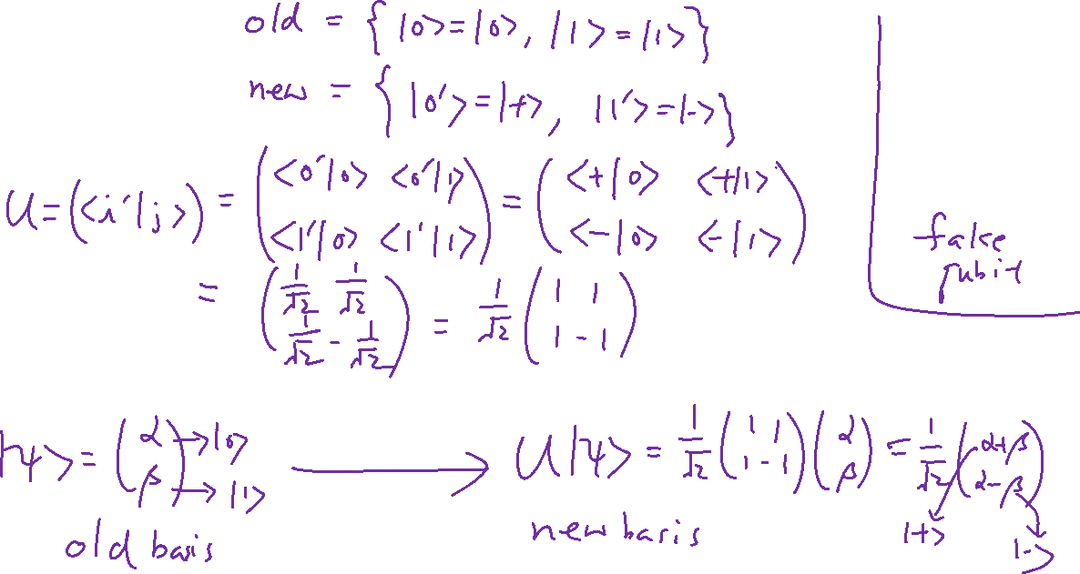
Example

Slide 10





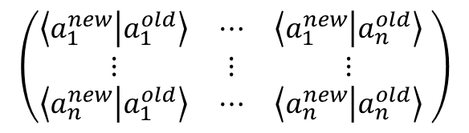

Summary
Adjoint
$$A^{†}=A^{T∗}$$
Self-Adjoint (Hermitian) Matrices, real eigenvalues
$$A^{†}=A$$
Unitary Matrix
$${U^{†}U}^{}=U^{}U^{†}=I$$
$\left\langle f | g\right\rangle$=$\left\langle Uf | Ug\right\rangle$
Inner product conserved
Construction of Unitary Transformation Matrix
$$\left(\begin{matrix}\left\langle a_{1}^{new} | a_{1}^{old}\right\rangle & ⋯ & \left\langle a_{1}^{new} | a_{n}^{old}\right\rangle \\ ⋮ & ⋮ & ⋮ \\ \left\langle a_{n}^{new} | a_{1}^{old}\right\rangle & ⋯ & \left\langle a_{n}^{new} | a_{n}^{old}\right\rangle \end{matrix} \right)$$
$$a_{i}^{new}$$
$$a_{i}^{old}$$
: Old basis
: New basis

Slide 11

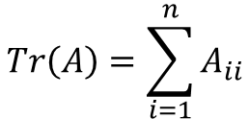
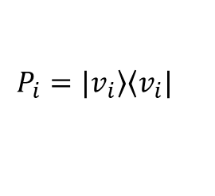


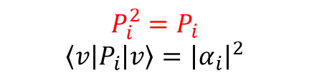
Summary
Projection Operator/ Projector
$$P_{i}^{2}=P_{i}$$
$$\left\langle v | P_{i} | v\right\rangle ={\left|α_{i}\right|}^{2}$$
$$P_{i}=\left.|v_{i}\right\rangle \left\langle v_{i}|\right.$$
Project any vector to vector $\left.|v_{i}\right\rangle$
$$Φ^{+}=\frac{1}{\sqrt{2}}\left(\begin{matrix}\begin{matrix}1 \\ 0\end{matrix} \\ \begin{matrix}0 \\ 1\end{matrix}\end{matrix}\right) Φ^{−}=\frac{1}{\sqrt{2}}\left(\begin{matrix}\begin{matrix}1 \\ 0\end{matrix} \\ \begin{matrix}0 \\ −1\end{matrix}\end{matrix}\right)$$
$$ψ^{+}=\frac{1}{\sqrt{2}}\left(\begin{matrix}\begin{matrix}0 \\ 1\end{matrix} \\ \begin{matrix}1 \\ 0\end{matrix}\end{matrix}\right) ψ^{−}=\frac{1}{\sqrt{2}}\left(\begin{matrix}\begin{matrix}0 \\ 1\end{matrix} \\ \begin{matrix}−1 \\ 0\end{matrix}\end{matrix}\right)$$
Bell States
Entanglement
$$|\left.ψ\right\rangle ≠|\left.ψ_{1}\right\rangle ⊗|\left.ψ_{2}\right\rangle$$
Trace of Matrix (next topic)
$$Tr\left(A\right)=\sum_{i=1}^{n}{A_{ii}}$$

Slide 12
Pauli Matrices
Chapter 5 of “Quantum Computing Architecture and Hardware for Engineers: Step by Step”
Introduction to Quantum Computing From a Layperson to a Programmer in 30 Steps – YouTube
https://www.youtube.com/playlist?list=PLnK6MrIqGXsJfcBdppW3CKJ858zR8P4eP

Slide 13
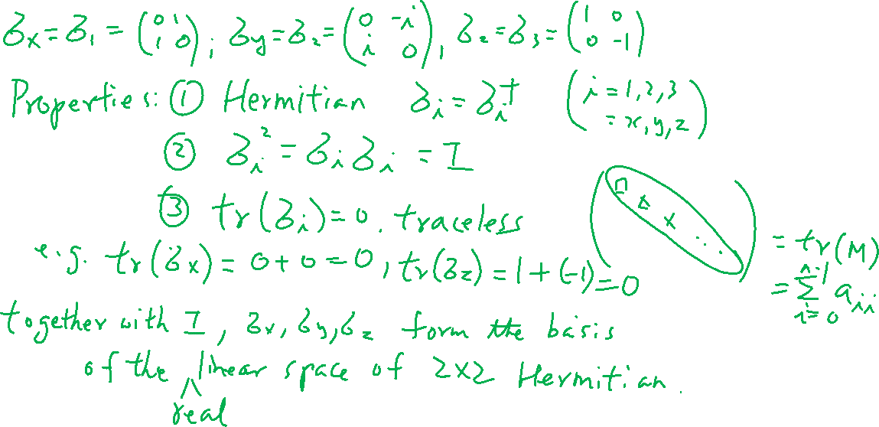
Pauli Matrices
Learning outcomes: Memorize the matrices and understand that with the identity matrix, they form the basis of any 2X2 matrices

Slide 14
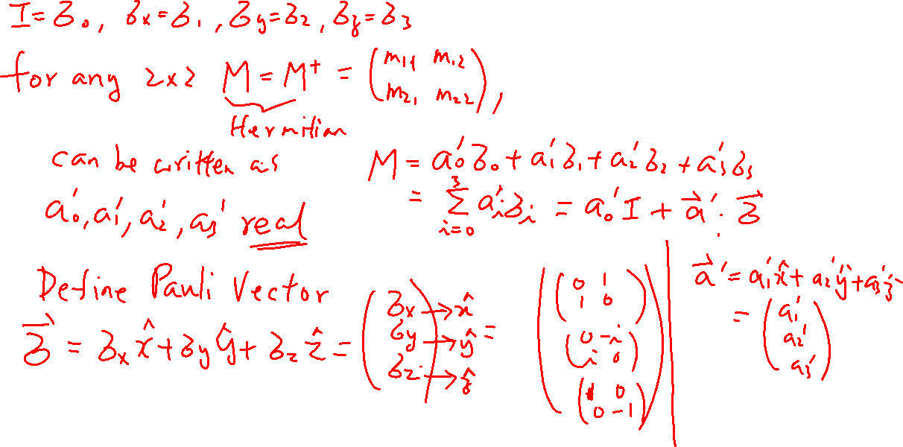
Wiki:

